Slide 1
Adestra
Conversion Tracker
Configuration & Consultation

Slide 2
Agenda
Conversion Tracker Overview
What’s Included
Our Process
Set-Up & Configuration Steps
Exercise

Slide 3
1
Conversion
Tracker Overview

Slide 4
What email conversions are you tracking?
Member join or Foundation / Donation
Product/Webinar purchase
Conference registration
A member, customer,
or prospect taking
action on your goal.

Slide 5
What is
conversion
tracker?
Conversion Tracker
Is a method of tracking the journey when a customer, member, or prospect takes the desired action and attributes the conversion back to the email send.

Slide 6
Ways to use the Conversion Tracker Data
Run an Export Manager report on the overall email program at a regular cadence to attribute X dollars (ROI) to your email promotions
Automation program scenario: Because you clicked from my emails and made it 50% of the way through the journey on my website (but didn’t convert) then I want to nurture you in one of my warm leads drip campaigns
Automation program scenario: Because you clicked from my emails and made it 100% of the way through the journey on my website (converted), then I want to nurture you in one of my warm drip campaigns

Slide 7
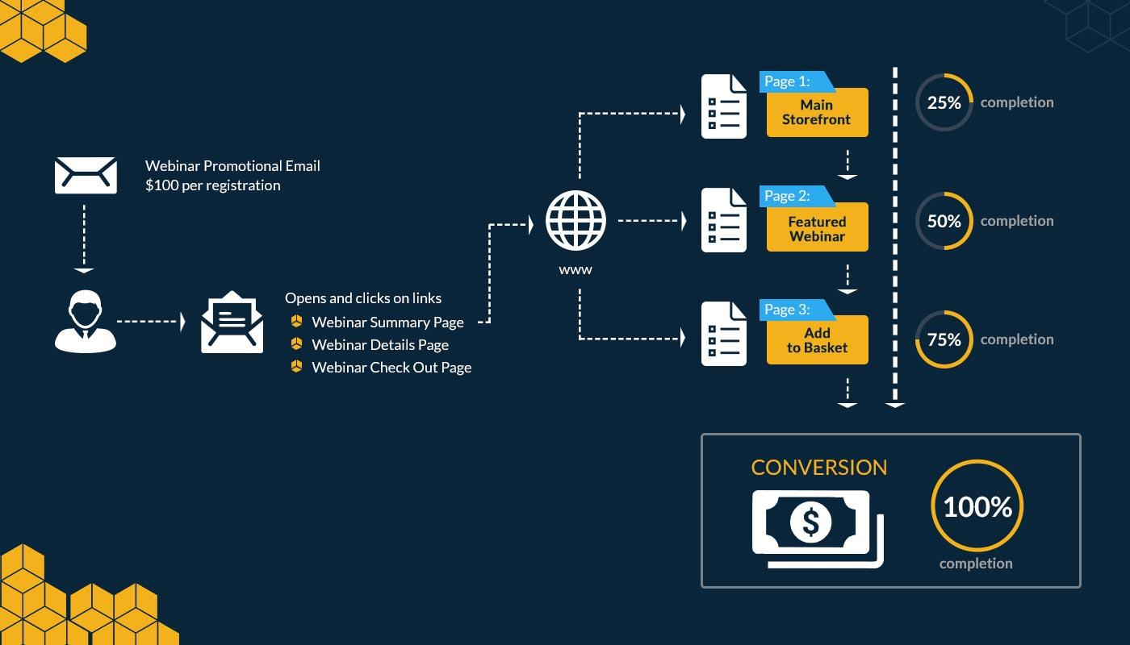
Conversion Tracker
How it works.

Slide 8
Tracker vs. Capture
Tracker
Capture
Customer took an action
Originates from an email
Valuable for Attribution & Analytics
Further automation is required
Customer didn’t take an action
Originates from outside email
Valuable for recovering abandoned carts
Triggers timely, personalized emails when a customer fails to check out

Slide 9
2
What’s Included

Slide 10
Three Journeys
Signature event: 4-8 pages
Products/Webinars: 3 pages
Member join: 4-6 pages

Slide 11
3
Our process

Slide 12
What HRS will do
What Client will do
Activate Conversion Tracker in workspace
Develop web code based on requirements collected
Provide training and support on Conversion Tracker and Reporting
Complete Conversion Tracker Workbook
Drop web code on website and tag the page types (ie event page, product page) identified as steps in the journey

Slide 13
Conversion
Tracker
Steps
4
3
2
Build
HRS will build out the aggregate report for analytics and reviewing results and advise on subsequent drip campaigns
1
Connect
Code
HRS will take the output of the workbook and build the Conversion Tracker code
Client will drop Conversion Tracker code onto all relevant websites
Configuration
Client to fill out the Workbook based on what they’re looking to track
the what: marketing
the how: tech

Slide 14
4
Set-Up

Slide 15
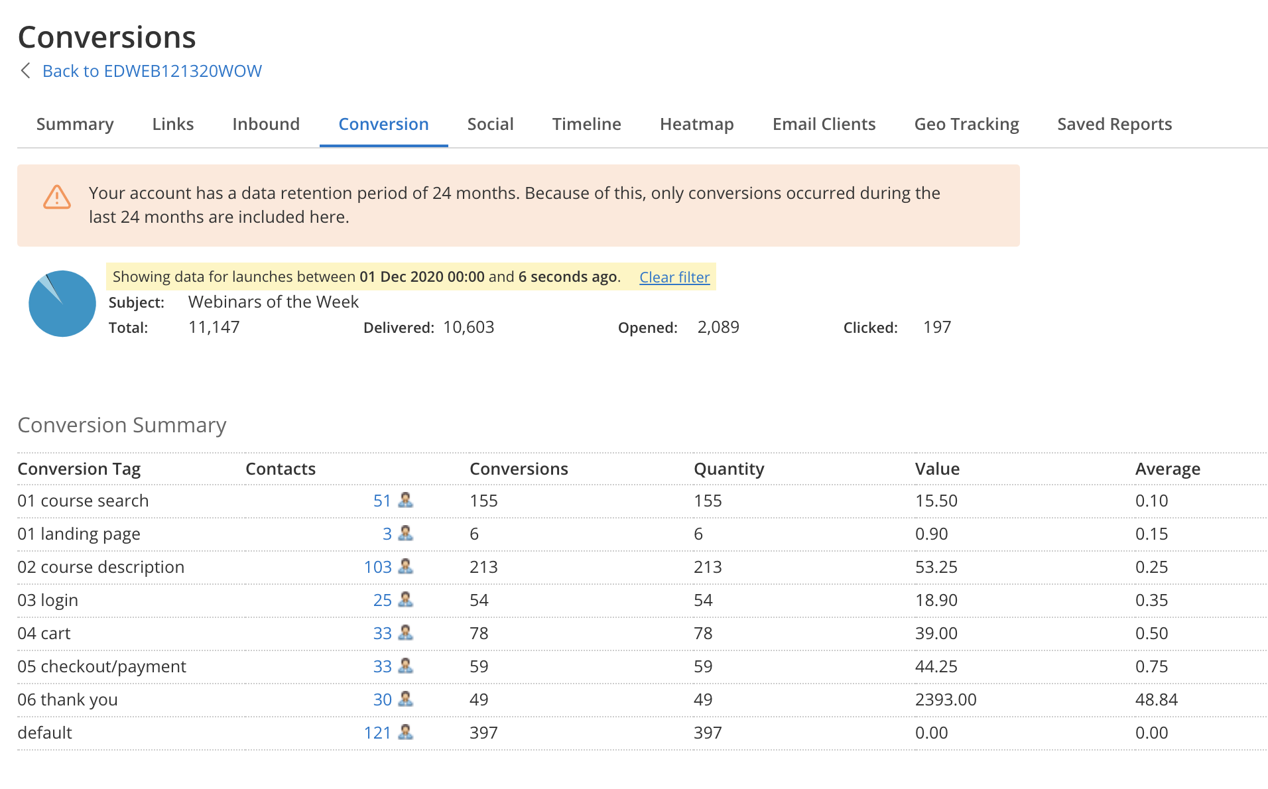
What reporting you’ll start to see
Organized by Conversion Tag
ROI written back at100% completion of journey (i.e. 10 Confirmation)
Incomplete journeys still show value

Slide 16
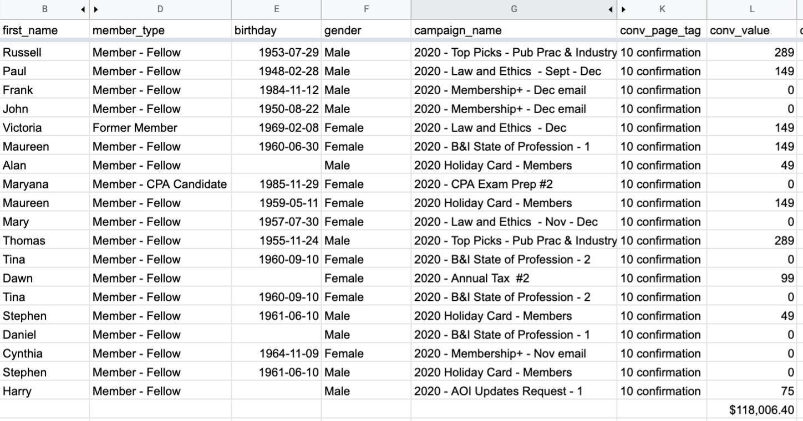
What your report might look like
30 day report
$118k ROI
Ability to sort by project, campaigns, include other demographic information

Slide 17
Definitions:
Tag: This defines the page and information you want to record.
Value: You can add a value when you are recording transactional data.
Quantity: A quantity can be added for processes that involve multiple buys or downloads.
Order: For transactional processes visitors may be given order numbers which can also be recorded.

Slide 18
Your script might look like this:
<script src="https://apps4.highroadsolution.com/clients/CLIENT/scripts/CLIENT_tracker.js"></script>

Slide 19
5
Exercise

Slide 20
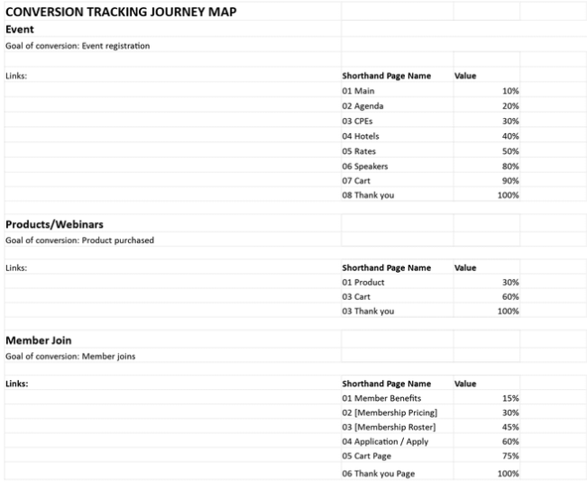
Exercise Workbook

